Slide 1
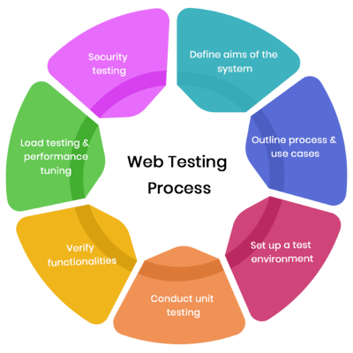
Web Security Testing
Tools for Web Security Testing

Slide 2


Web Application
A website always works based on client-server technology. That is basically how we get data from a server and a client
Two major components that make up a website are the Front End and the Back End
Every Website will always have some kind of server where it stores all of its data
Websites make use of HTTP or HTTPS as a request-response protocol to communicate with the servers

Slide 3
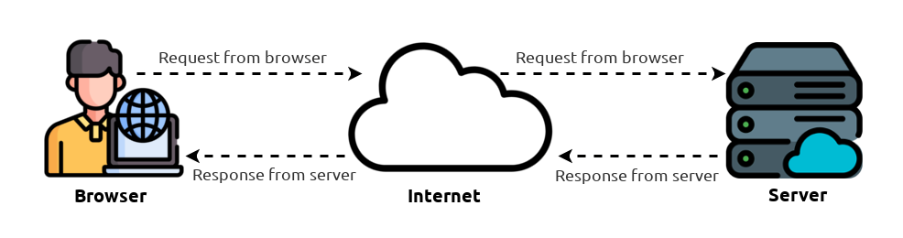
Web Application

Slide 4


Web Applications Security Testing
Comprehensive Guide
Comprehensive guide for web application and services testing
Testing Resources
Provides Testing resources for web application developers as well as security professionals
Framework
It provides penetration testers with the framework of best practices
Improving Security
The OWASP WSTG works towards improving security through its community-led resources worldwide

Slide 5
OWASP Top 10 Web Vulnerabilities
Broken Access Control
Cryptographic Failures
Broken Access control had more occurrences in applications than any other category with 34 CWEs being mapped to it
Previously known as Sensitive Data Exposure.
Focuses on failures related to cryptography
Injection
Insecure Design
The injection has the second most occurrences in application with 33 CWEs being mapped to it, Cross-site scripting is now a part
The new category for 2021, focuses on design flaws
Security Misconfiguration
Vulnerable & Outdated Components
Moved up from #6, 90% of applications were tested for some form of misconfiguration, XXE a part
Previously known as Using components with known vulnerabilities

Slide 6
OWASP Top 10 Web Vulnerabilities
Identification and Authentication Failures
Security Logging and Monitoring Failures
Previously known as Broken Authentication, slid down from the second position.
Previously Insufficient Logging & Monitoring. Added from the industry survey, moved up from #10 previously
Software and Data Integrity Failures
Server-Side Request Forgery
New Category, focuses on making assumptions related to software updates, critical data.
Insecure Deserialization is now a part
Added from Top 10 community survey, has relatively low incident rate with above average ratings for exploit and Impact potential

Slide 7



Burp Suite
Can be used for detailed enumeration and analysis of web applications
Number one penetration testing tool when it comes to web application pen-testing
Can simply intercept HTTP/S requests and act as a middle-man between the user and web pages
02
An intercepting proxy that is specially designed for penetration testing
Can Capture necessary details from the website as the user navigates around
04
Allows us to list out each domain in our scope and let’s us modify our interactions with the webpage
Intercepting traffic from a browser to a webpage allows us to modify and automate changes to webpage requests
Acts as a middle-man between the user and website

Slide 8

Subfinder
Basically, we want to identify as many endpoints as possible, sort and filter them, scan them automatically and perform manual assessments where applicable
Subfinder is a subdomain discovery tool that discovers valid subdomains for websites.
Designed as a passive framework to be useful for bug bounties and safe for penetration testing
02
We need to identify assets which belong to the target company and are in-scope. The first thing is to identify domains and sub-domains belonging to the target.
04
Subdomain enumeration become more and more important for an attacker in the last few years and different tools with different approaches are been developed so far.
Allows us to list out each domain in our scope and let’s us modify our interactions with the webpage

Slide 9

GoSpider
While testing Web Applications we need to get a good view of all the pages and endpoints your targets host.
GoSpider is a tool written in Go that helps you to enumerate all endpoints on your target!
Manually enumerating those can become labour intensive, boring and on top of that, is prone to errors
02
It takes a URL or a list of URLs and will then query them whilst scanning the responses for more URLs on the same domain
Spidering is a crucial step when it comes to WebAPP Pentesting and Bug Bounty
04
It offers the capability to check for certain vulnerabilities on the wild, that could reveal sensitive information and more
It does that recursively and thus gives you a ton of results!

Slide 10


WFuzz
Wfuzz is a tool designed for brute-forcing Web Applications
It can be used for finding resources not linked directories, servlets, scripts,, etc.
Wfuzz’s web application vulnerability scanner is supported by plugins.
Wfuzz provides a framework to automate web applications security assessments and could help you to secure your web applications by finding and exploiting web application vulnerabilities.
02
04
It allows any input to be injected in any field of an HTTP request, allowing to perform complex web security attacks in different web application components such as: parameters, authentication, forms, directories/files, headers, etc.
Wfuzz is a completely modular framework and makes it easy for even the newest of Python developers to contribute

Slide 11


Wappalyzer
Information gathering is key and Wappalyzer can definetly help with recon
Wappalyzer is a technology profiler that shows us what websites are built with
02
04
Wappalyzer is a technology stack analyzing platform founded by Elbert Alias in 2008
It detects the different technologies that categorize into a wide variety of categories, including analytics tools, server software, advertising networks, javascript framework, and many more.

Slide 12

Nuclei
Nuclei is a tool by Project Discovery.
It is a very powerful tool that helps automate vulnerability scanning, reconnaissance and penetration testing easily.
Nuclei templates automate many tasks that would otherwise be manual
02
It is an open-source tool that enables fast and customizable vulnerability scans based on simple YAML and DSL.
This not only reduces the time to find network vulnerabilities, but also lends to greater confidence in results with fewer false positives
04
Nuclei uses templates that can scan protocols including TCP, SSH, DNS, HTTP, SSL and many more, Nuclei sends requests across targets to provide quick and large-scale vulnerability scanning.

Slide 13
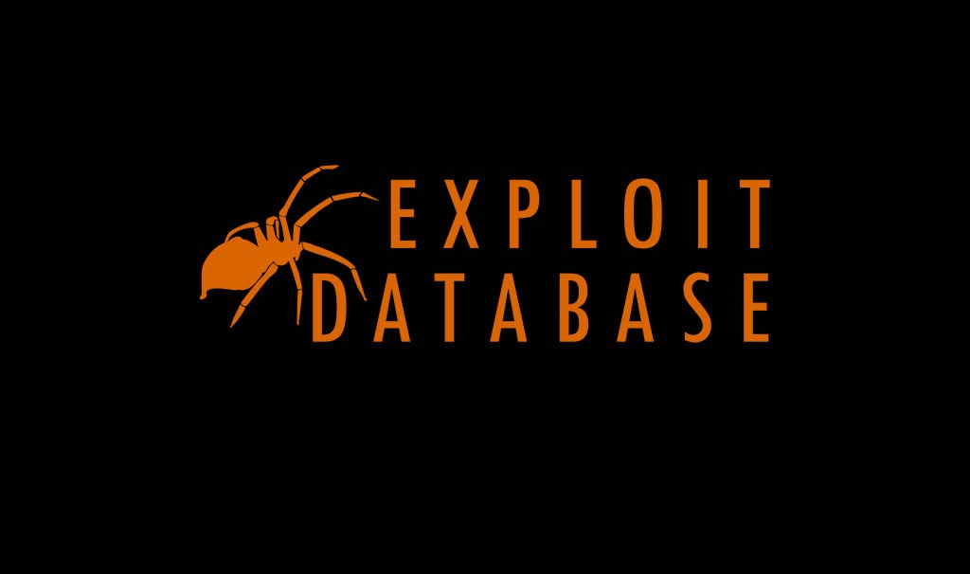

ExploitDB
Exploit Database (ExploitDB) is an archive of exploits for the purpose of public security, and it explains what can be found on the database.
The ExploitDB is a very useful resource for identifying possible weaknesses in your network and for staying up to date on current attacks occurring in other networks.
02
It is a CVE compliant archive of public exploits and corresponding vulnerable software, developed for use by penetration testers and vulnerability researchers.
04
The Exploit Database is maintained by Offensive Security, an information security training company that provides various Information Security Certifications as well as high end penetration testing services.

Slide 14
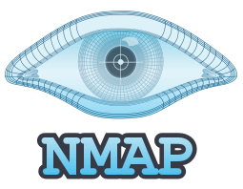
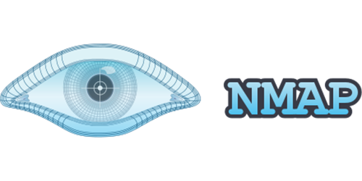
Nmap
Nmap, short for Network Mapper, is a free and open source tool used for vulnerability checking, port scanning and, of course, network mapping.
Despite being created back in 1997, Nmap remains the gold standard against which all other similar tools, either commercial or open source, are judged.
Many systems and network administrators also find it useful for tasks such as network inventory, managing service upgrade schedules, and monitoring host or service uptime.
02
Nmap is often used to determine alive hosts in a network, open ports on those hosts, services running on those open ports, and version identification of that service on that port.
04
It can be used by penetration testers to identify open ports to gather more information about a target, or can be used by a security administrator to identify open ports in their systems but are not in use.

Slide 15

MassScan
Masscan is a network port scanner, similar in many ways to the well-known Nmap command
Masscan uses its own ad hoc TCP/IP stack
The goal of Masscan, however, is to enable security researchers to run port scans on large swathes of the Internet as quickly as possible
02
Masscan is useful for red teamers doing offensive research (like penetration testing) as well as blue teamers and IT managers doing defensive research (like finding attack vectors within their network)
04
It uses asynchronous transmission, similar to port scanners like scanrand, unicornscan, and ZMap. It's more flexible, allowing arbitrary port and address ranges.
It is an Internet-scale port scanner. It can scan the entire Internet in under 5 minutes, transmitting 10 million packets per second, from a single machine.

Slide 16

SHODAN
Shodan is a database of billions of publicly available IP addresses, and it’s used by security experts to analyze network security.
Users can perform a search using the Shodan search engine based on an IP address, device name, city, and/or a variety of other technical categories
Shodan crawls the web for devices using a global network of computers and servers that are running 24/7.
02
Shodan is a search engine, like Google, but instead of searching for websites, it searches for internet-connected devices from routers and servers, to Internet of Things (IoT) devices to complex systems that govern a wide range of industries, including energy, power, and transportation.
04
Shodan works by requesting connections to every imaginable internet protocol (IP) address on the internet and indexing the information that it gets back from those connection requests.
Shodan can find anything that connects directly to the internet and if your internet-facing devices aren’t protected, Shodan can tell hackers everything they need to know to break into your network.

Slide 17

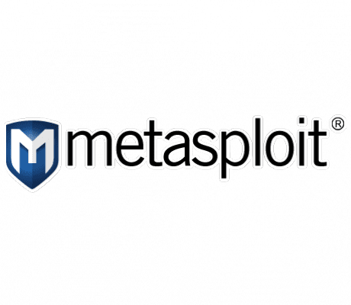
MetaSploit
Metasploit is a penetration testing framework that helps you find and exploit vulnerabilities.
Using Metasploit, we can access disclosed exploits for a wide variety of applications and operating systems
The Metasploit Framework is a set of tools that allow information gathering, scanning, exploitation, exploit development, post-exploitation, and more.
02
The Metasploit framework is a very powerful tool which can be used by cybercriminals as well as ethical hackers to probe systematic vulnerabilities on networks and servers.
04
Metasploit now includes more than 1677 exploits organized over 25 platforms, including Android, PHP, Python, Java, Cisco, and more.
While the primary usage of the Metasploit Framework focuses on the penetration testing domain, it is also useful for vulnerability research and exploit development.

Slide 18
Thank You!

